Slide 1

Overview of the IPCC AR6 reports. 2023-07-31
Waheb Mehdi (Intern, semanticClimate) B.Sc Hons, Aligarh Muslim University.

Slide 2
What is IPCC?
Regular assessments for policymakers. Providing in-depth evaluation of the current state of knowledge on climate change through assessment reports

Slide 3
Structure of the IPCC Data Corpus
Each of the seven reports in AR6 further contains chapters and Technical Summary(TS), Summary for PolicyMakers(SPM) and a Glossary etc.
Each chapter is of the size of a small book;
Chapter 8 of WG3, for instance has about 92 pages.

Slide 4
IPCC’s Corpus
Assessment Report 6
WG1
WG3
WG2
SRCCL
SYR
SR15
SROCC

Slide 5
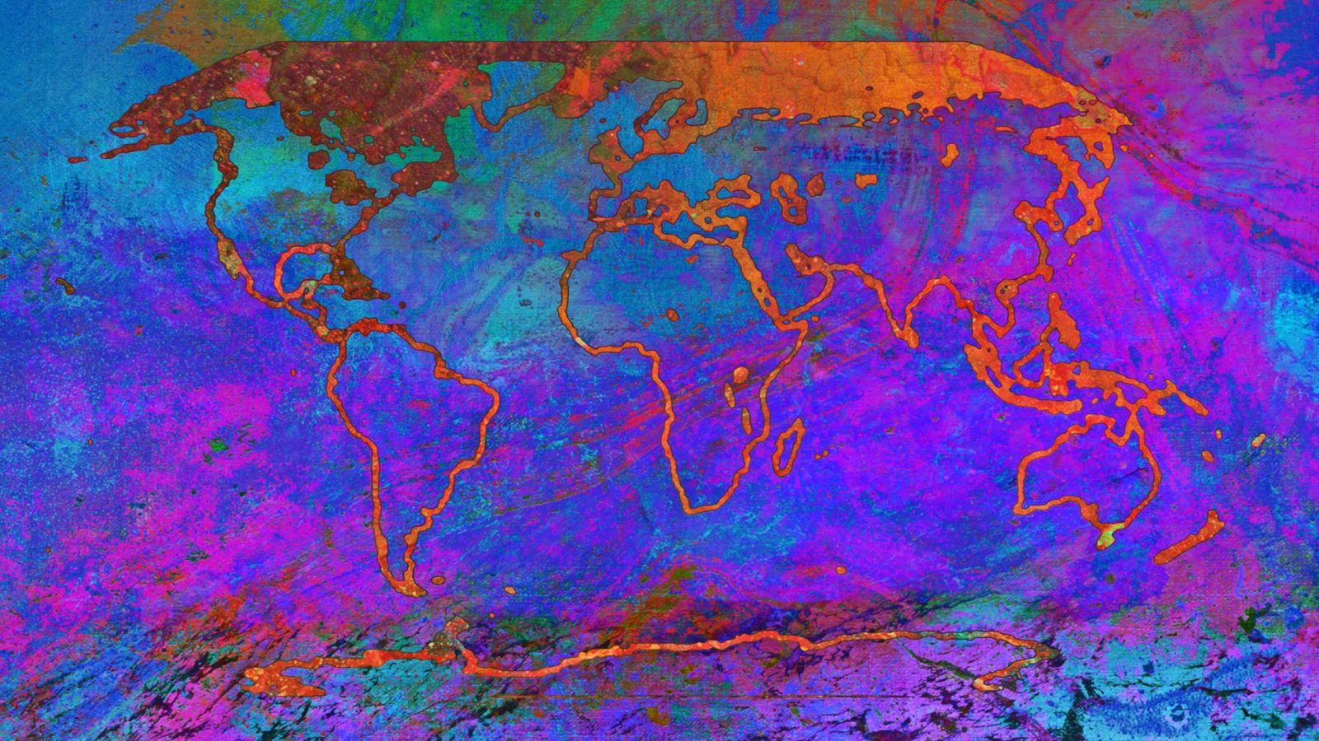
Working group 1 (WG1) Report:
Physical effects of climate change on the Earth. i.e., the atmosphere, ice etc.
“Examines the physical science underpinning past, present, and future climate change.” -IPCC

Slide 6
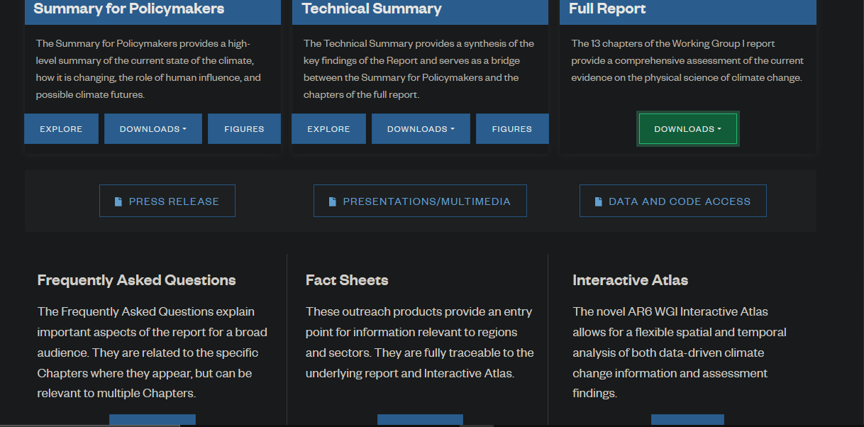
Typical IPCC Report
WG1
SPM
FAQ
Interactive Atlas
Chapters
TS
Glossary

Slide 7
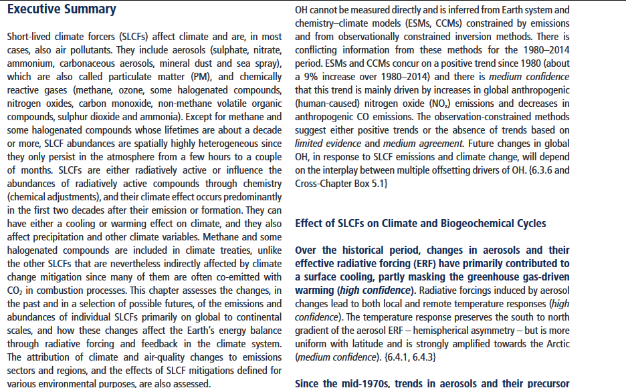
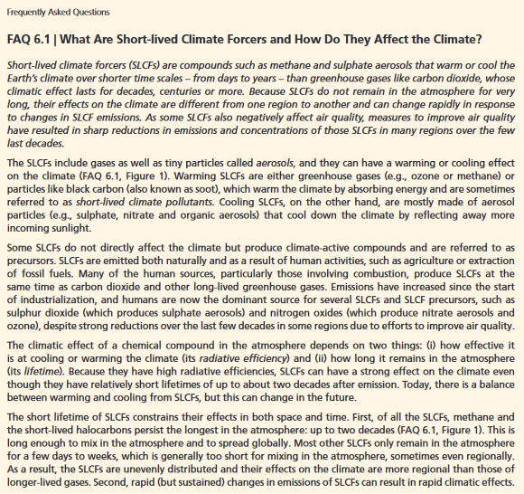
Typical IPCC Chapter
Chapter 06
Executive Summary
FAQ
Text
Figures
Boxes
Tables
References
Executive Summary(15) and (3) FAQs

Slide 8
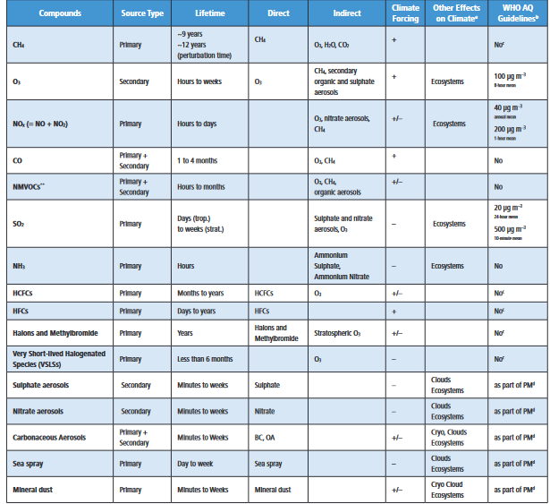
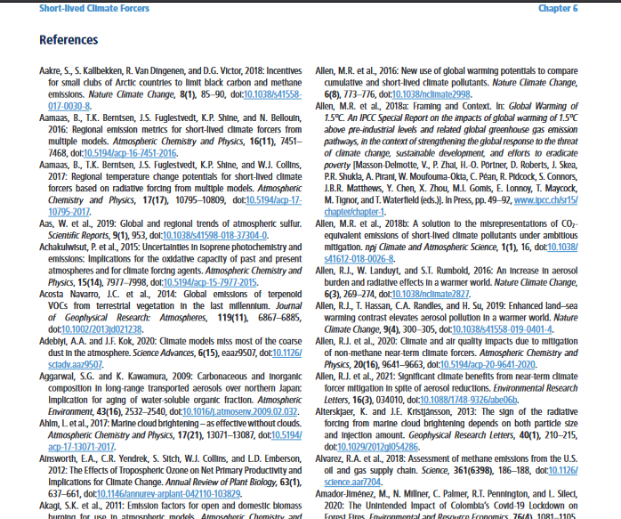
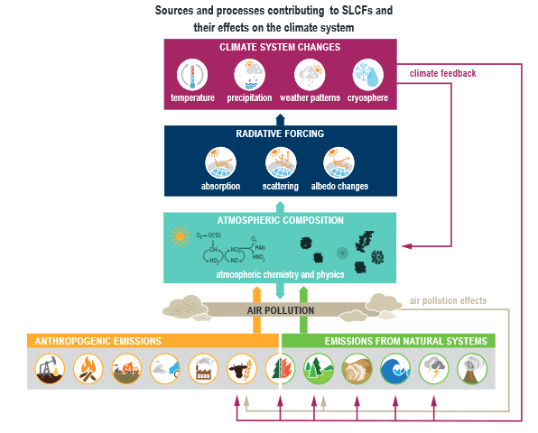
Tables, Figures and References from Chapter 6 (WG1)

Slide 9

Working group 2 (WG2) Report:
Effect of climate change on natural and human systems. For e.g., human health, agriculture etc.
“Reviews vulnerabilities and the capacities and limits of the natural world and human societies to adapt to climate change.” -IPCC

Slide 10
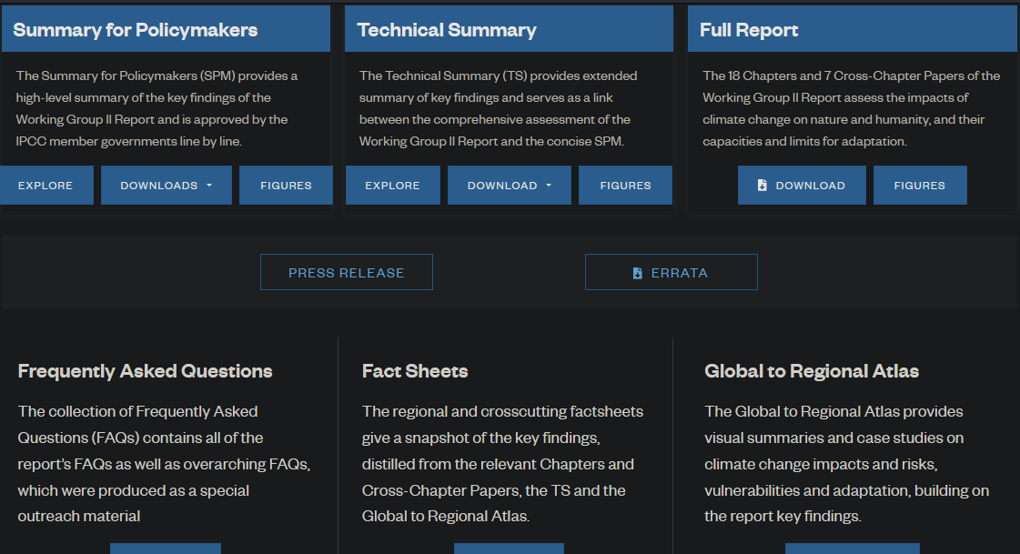
Typical IPCC Report
WG2
SPM
FAQ
Fact Sheets
Chapters
TS

Slide 11
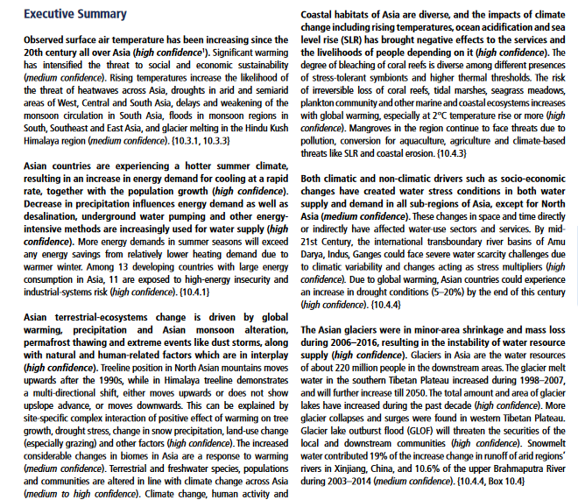
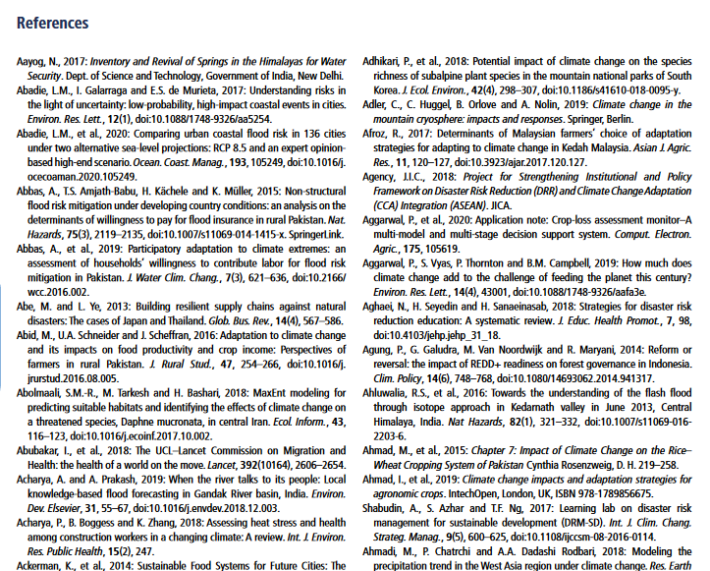
Chapter 10 (Asia)
Executive Summary
FAQ
Text
Figures
Boxes
Tables
References
Executive Summary and References

Slide 12
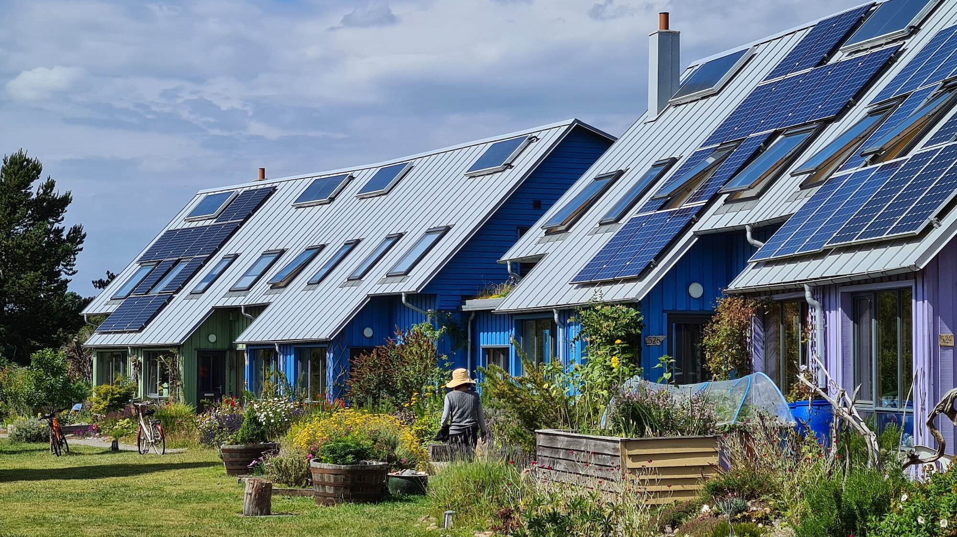
WG3 (Mitigation):
Talks about mitigation strategies such as adapting to a low-carbon economy WG III focuses on climate change mitigation like reducing greenhouse gases.
For more: Mahvish’s work on Cities and State Action Plan

Slide 13
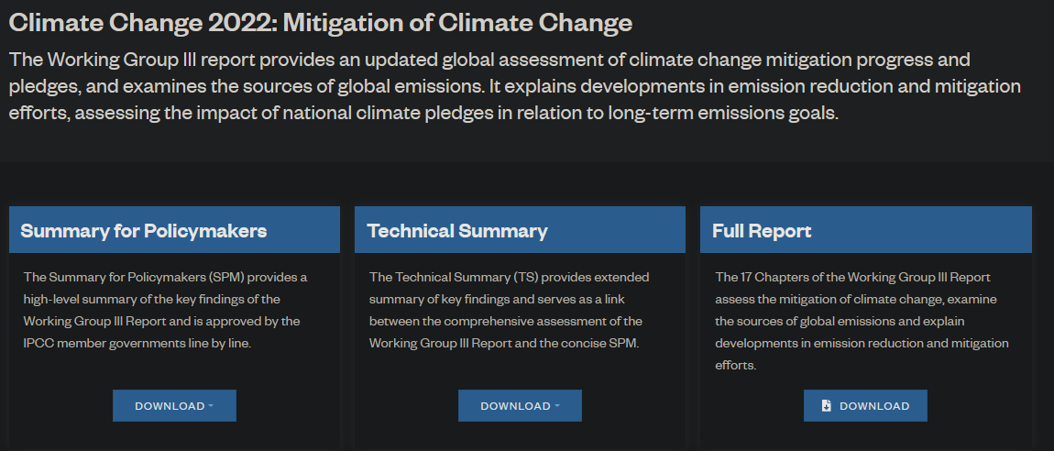
Typical IPCC Report
WG3 (Mitigation)
SPM
FAQ
Chapters
TS

Slide 14
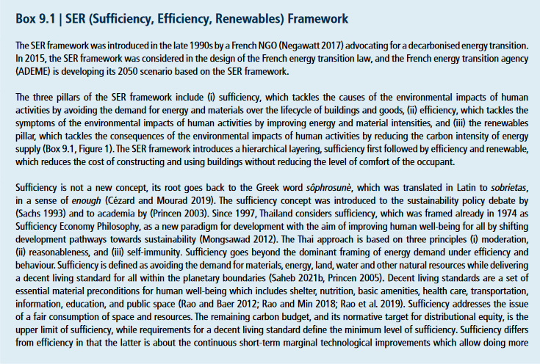
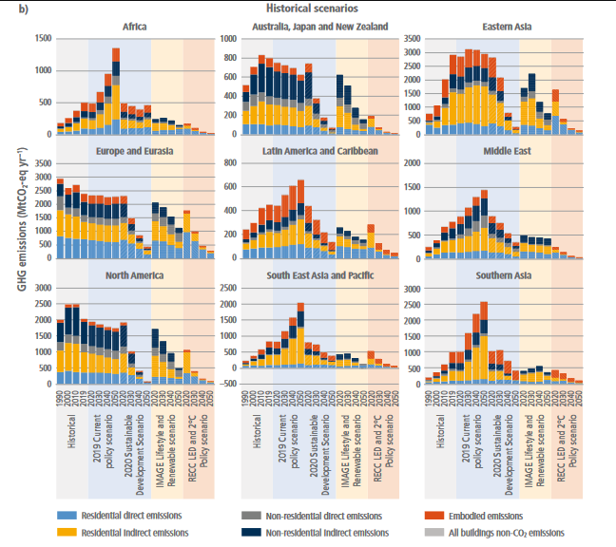
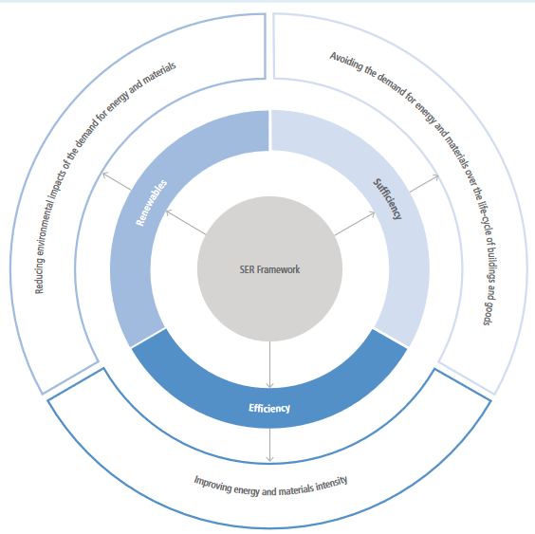
Boxes, Tables and Figures
Chapter 09 (Buildings)
Executive Summary
FAQ
Text
Figures
Boxes
Tables
References
Executive Summary, References and Figures

Slide 15

Synthesis Report 2023:
The SYR synthesizes key findings from the three working group reports and the three special reports Provides a summary of the state of knowledge on climate change.

Slide 16
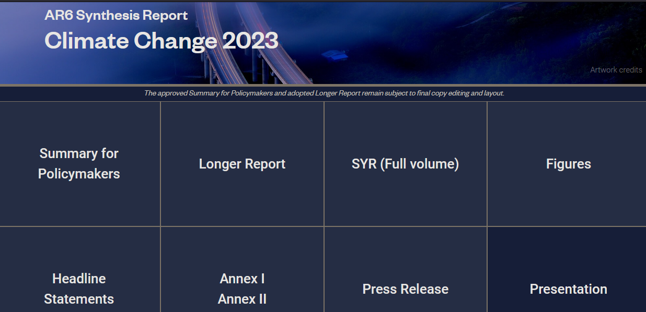
IPCC Synthesis Report
SYR (Summary Report)
SPM
Figures
Chapters
Longer Report
Annexes

Slide 17
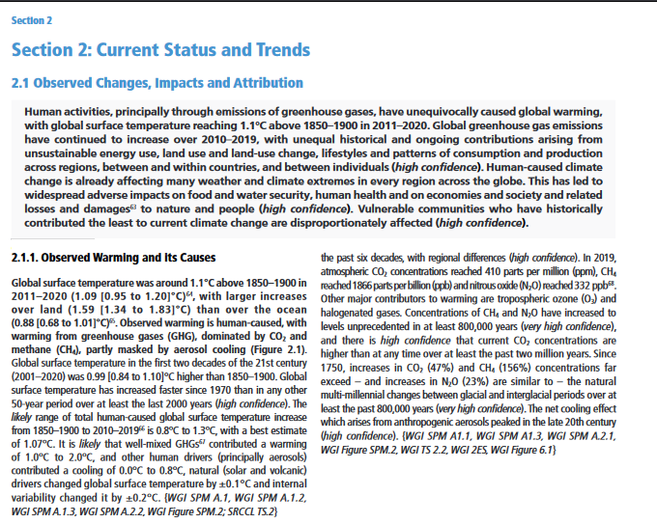
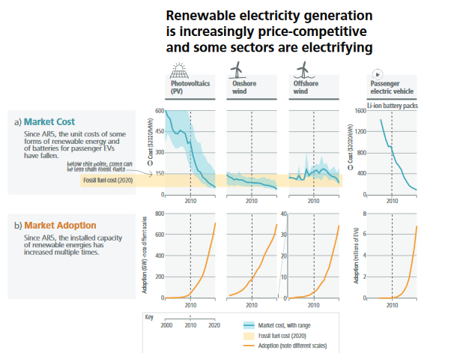
Text and Figures
Full Volume
Front matter (Preface and Foreword)
SPM
Sections
Annexes (Glossary)
Section 2

Slide 18
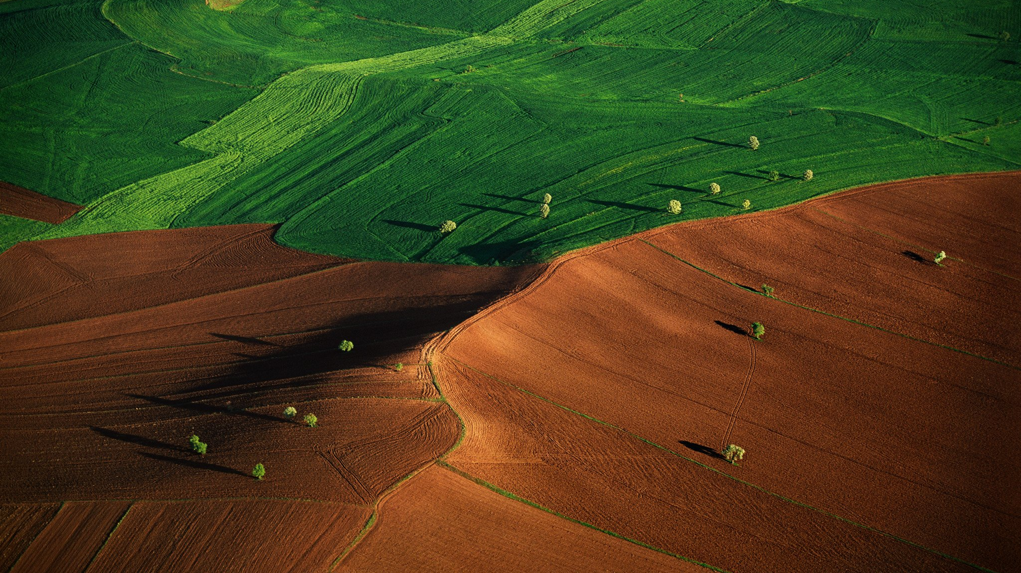
Special Report on Climate Change and Land (SRCCL):
Highlights links between climate change and land use. The impacts of unsustainable land management practices on ecosystems and food security.
For more: Yasin’s work on SRCCL

Slide 19
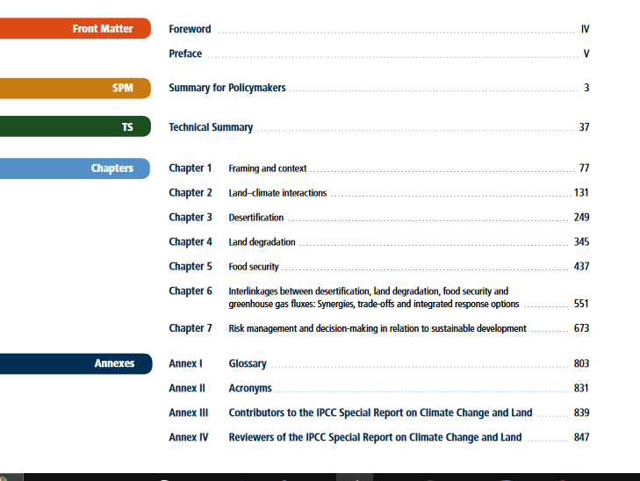
IPCC’s SRCCL Report
SRCCL (Land Climate Change)
SPM
Chapters
Technical Summary
Annexes

Slide 20
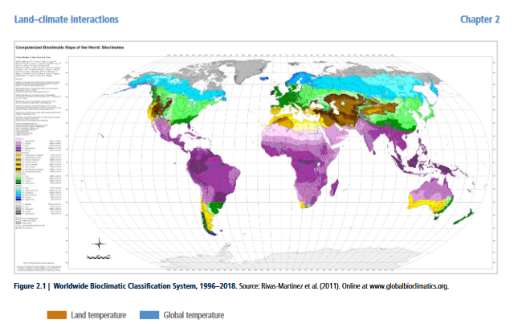
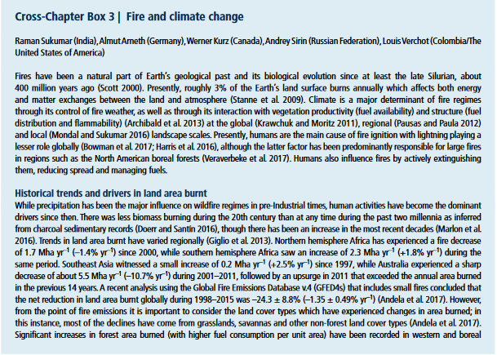
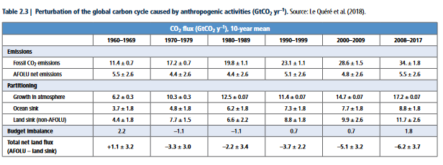
Boxes and Figures
Land-Climate Interactions (Ch 02)
Executive Summary
FAQ
References
Appendix

Slide 21

Special Report on Global Warming of 1.5°C (SR15):
An IPCC special report on the impacts of global warming of 1.5 °C above pre-industrial levels and related global greenhouse gas emission pathways
It addresses the urgency of taking ambitious measures to meet the 1.5-degree Celsius goal.

Slide 22
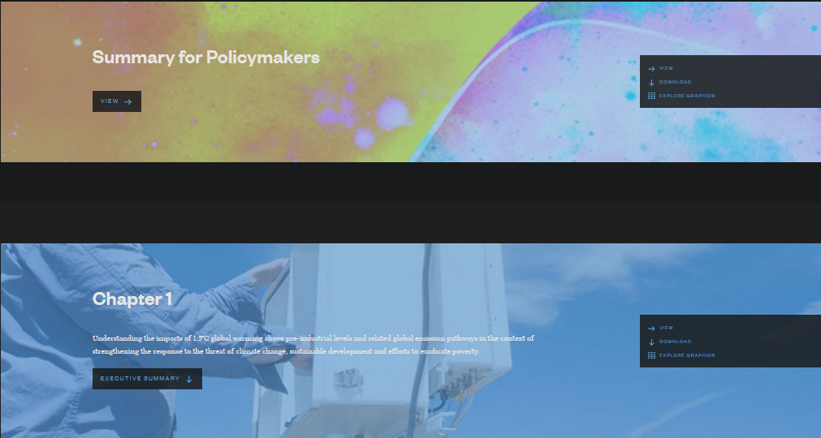
IPCC’s SR15 Report
SR15
SPM
Chapters
Glossary

Slide 23
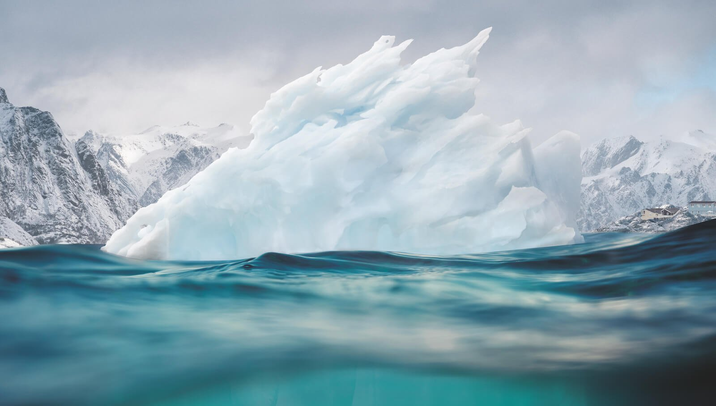
Special Report on the Ocean and Cryosphere in a Changing Climate (SROCC):
Effects of global warming on the cryosphere, namely the melting of ice caps, the rise of global sea levels and its consequences.
Also addresses the threat of marine biodiversity loss.
Refer to Shiwani’s work on Mountains for more

Slide 24
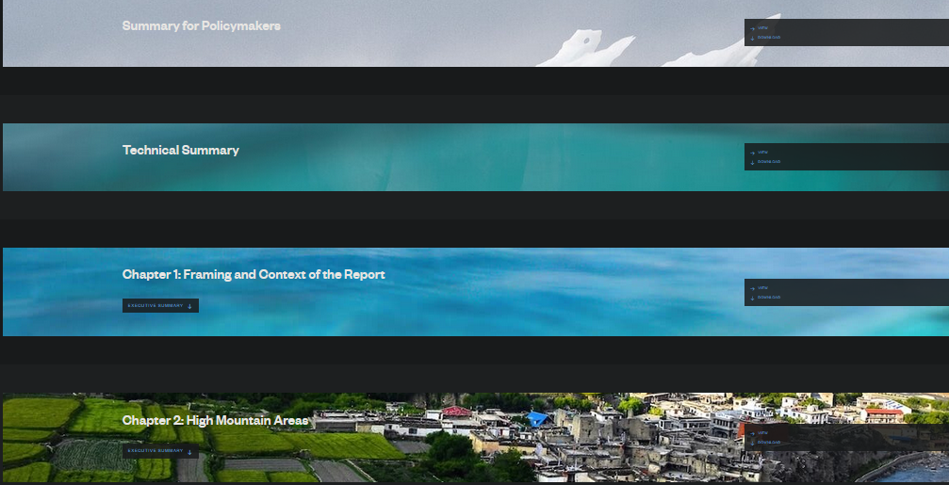
IPCC’s SROCC Report
SROCC (Ocean Climate Change)
SPM
Chapters
Technical Summary
Glossary

Slide 25
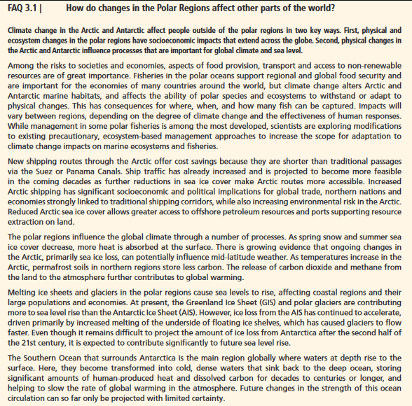
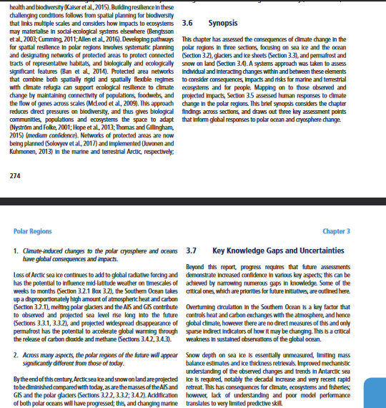
FAQs and Synopsis
Polar regions (Ch 03)
Executive Summary
Synopsis
References
FAQs
Knowledge Gaps

Slide 26


